Slide 1

IBM Applied Data Science
Capstone Project
Capstone Project by
Mohammad Ashraf Ansari
Powered by

Slide 2
Stakeholder Presentation
Problem Statement
Dataset
Use cases
The Solution

Slide 3
Predict average spend on Food & Beverages
by a holiday resort member
Problem Statement
The company, the most preferred holiday resort chain in India makes significant revenue from Food and Beverages (F&B) sales in their resorts. The members of the company club are offered a wide variety of items in either buffet or restaurant form.
Given the information related to resort, club member, reservation etc. the task is to predict average spend per room night on food and beverages for each reservation.
This is a regression problem, and we will train a machine learning model on the provided data to give the predictions.
The problem statement and data were provided by Club Mahindra at online hackathon DataOlympics in association with Analytics Vidhya:
https://datahack.analyticsvidhya.com/contest/club-mahindra-dataolympics/

Slide 4
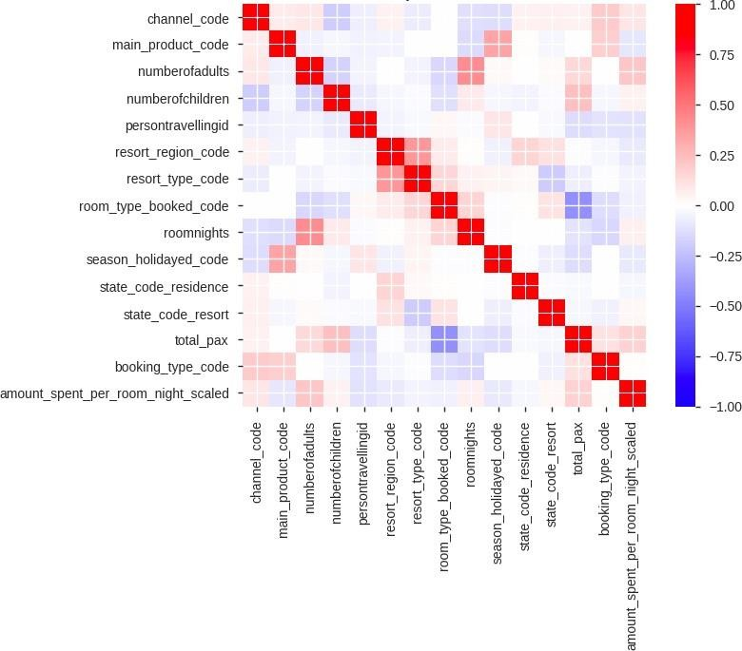
The Dataset
Dataset info
Variable types
Correlation Matrix
Number of variables 24
Numeric 11
Number of observations 314 424
Categorical Date
14
3
Total Missing (%) 0.1%
The variables have been anonymized:
Categories (resort, state etc.) replaced with codes.
Target variable (amount spent per room night) scaled.
The variables most correlated with the target:
total_pax – total number of persons travelling
numberofadults – number of adults travelling
roomnights – number of room nights booked
channel_code – different channels for booking
state_code_resort – state in which resort is located

Slide 5







The Use Case and the Solution
Following are some benefits the prediction model will bring:
Predicting the F&B spend of a member in a resort would help in improving the pre-sales during resort booking through web and mobile app.
Targeted campaigns to suit the member taste and preference of F&B.
Providing members in the resort with a customized experience and offers.
Help resort kitchen to plan the inventory and food quantity to be prepared in advance.
The data preparation and model training is conducted with Watson Studio. It uses Python, scikit learn and Jupyter technology. And deployed as a web-service with IBM Cloud.
The solution architecture:
User
Watson Studio
Docker
WEB UI
Python
Jupyter
Scikit Learn
Flask REST API
Scikit Learn Model

Slide 6
Technical Presentation
Architectural choices
Data quality assessment, data pre-processing and feature engineering
Model performance indicators
Model algorithm

Slide 7
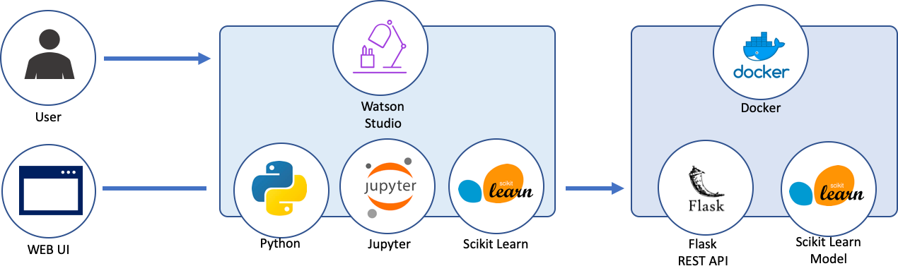
Architectural Choices
Core solution:
User provided CSV file uploaded to Watson Studio / IBM Object Storage.
Scikit-learn and Python in IBM Watson Studio with Jupyter notebooks:
ETL; Data Exploration.
Feature Engineering; Model Definition and Validation.
Pipeline Notebook (takes raw CSV data and outputs the trained pipeline ready for deployment).
Trained model is saved and deployed as Flask REST API with Dash UI hosted at IBM Cloud.
Alternative solution:
IBM Watson Studio Data refinery flow for raw data preparation.
Watson Machine Learning automatic modeling deployed as REST API web-service.

Slide 8
Data Pre-Processing and Feature Engineering
EDA Feature Engineering
Pre-processing
24 variables and 314 424 observations (unique reservations).
0.1% of total values are missing, 1.4% of missing values
in resort_type_code.
booking_date, checkin_date and checkout_date are date variables and should be parsed to datetime format at data loading stage.
memberid has high cardinality: 101 327 unique values.
numberofchildren has 77.4% of zero values.
Date features: booking_in_advance, days_stayed
Other features containing the information from the date (month, week, dayofweek, is_month_start etc.)
Other features (n_people etc.)
Fill NA values with -1
Convert binary-type columns values to [0, 1]
OHE for categorical features
Scale the numerical features

Slide 9
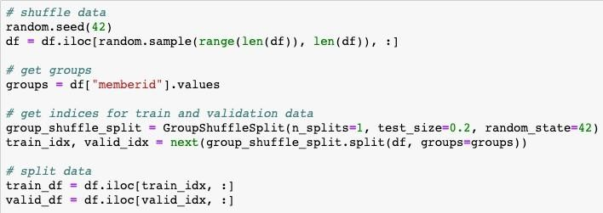
Model Performance Indicators
The model is evaluated on Root-Mean-Squared-Error (RMSE) between the predicted value and the observed amount spent.
The train/valid split performed based on memberid variable to prevent the data leak: we want to be able to predict the amount spent for the new members of hotels.

Slide 10
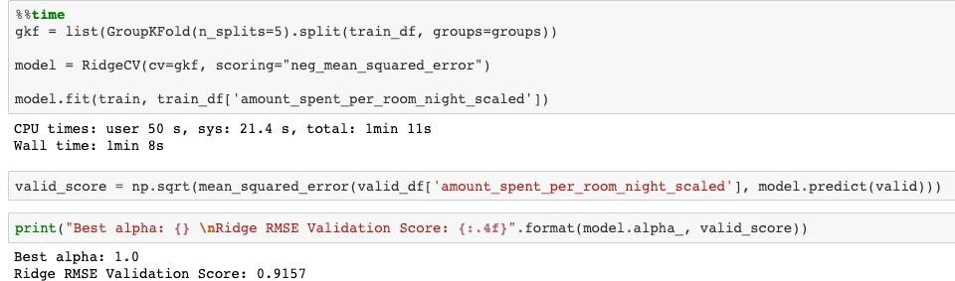
Model Algorithm
The chosen model is Linear Regression with L2 regularization (Ridge Regression).
Model parameters are tuned on 5-fold cross validation stratified by memberid groups. The model performance is than validated with unseen data:
The model is trained and cross-validated in under 2 minutes with Watson Studio Lite plan (1 vCPU and 4 Gb RAM) and shows RMSE score of 0.9157.

Slide 11
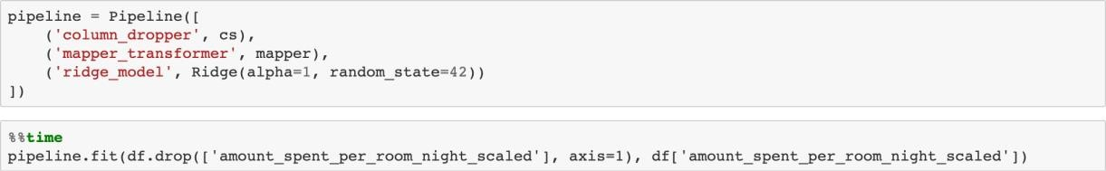
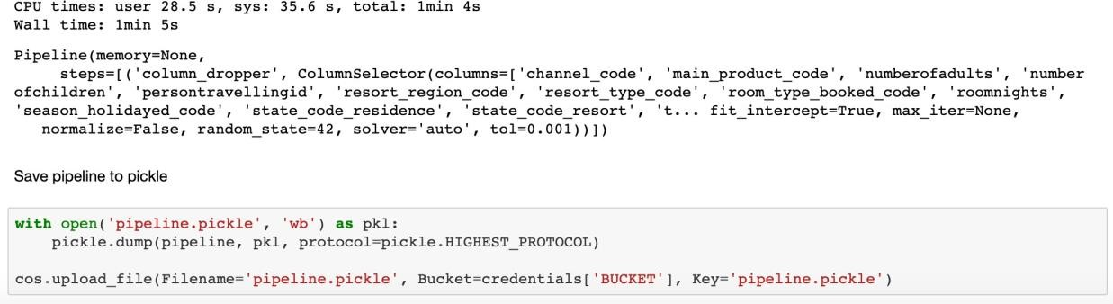
Model Deployment
After model training and evaluation, we create separate Jupyter notebook with full pipeline:
Loading data.
Pre-processing.
Create and save sklearn pipeline object to pickle file:
Choose columns
Transform columns
Train the model
The fitted and trained pipeline is then deployed as Flask REST API service with minimalist web-interface created with Dash, running at IBM Cloud.

